Slide 1
LAB 1- LAN
Switch Basic Operation
Learning outcomes:
  CONNECT AND CONFIGURE SWITCH IN LOCAL AREA NETWORK (P4)
  DIFFERENTIATE THE HARDWARE USED IN LAN (C4)

Slide 2
Connecting LAN
Hubs/Repeaters
Switches
Bridges
Routers
Gateways

Slide 3
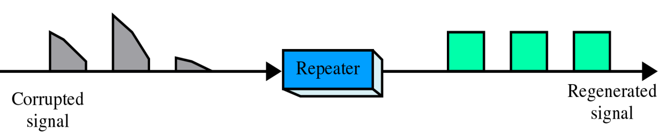
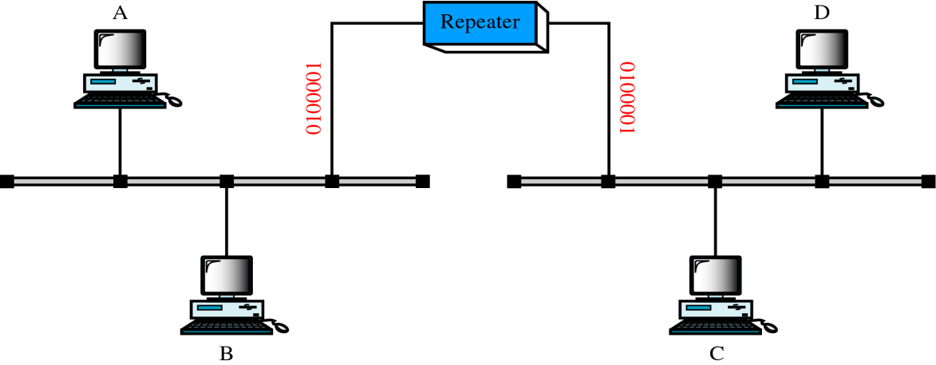
Hubs/Repeaters
regenerate electrical data signals
takes the incoming packet and copies it out to all other ports
operate at the Physical Layer

Slide 4
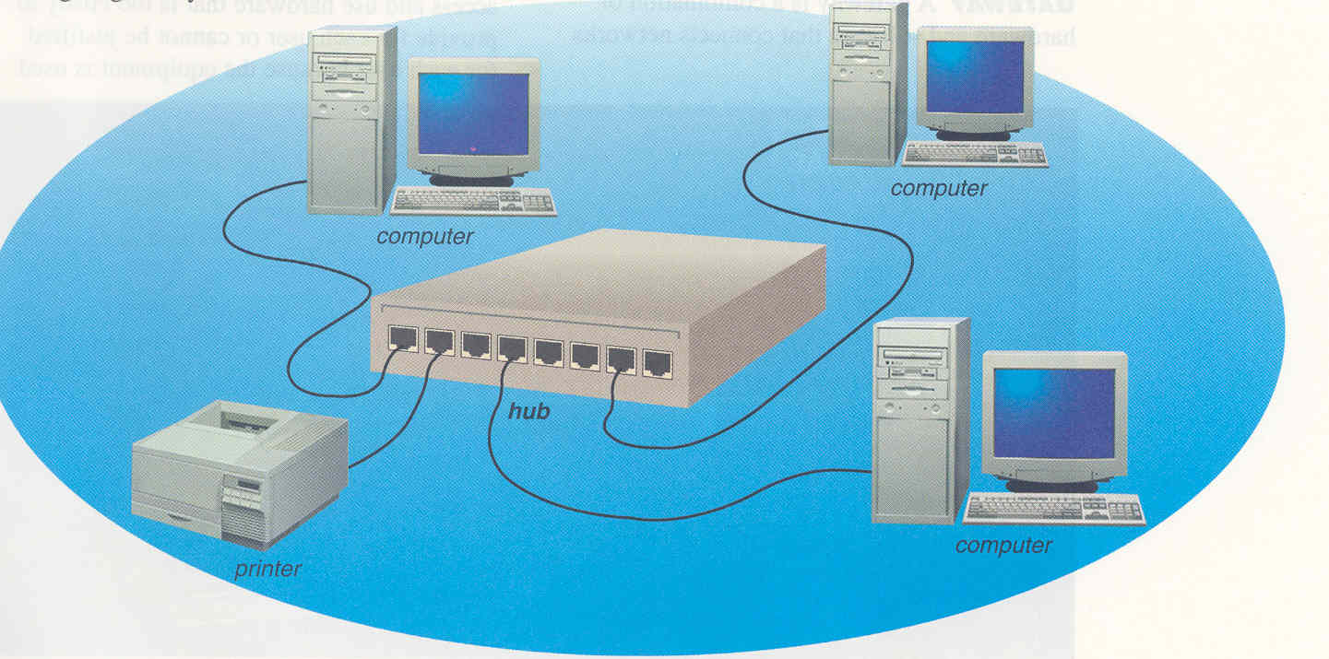
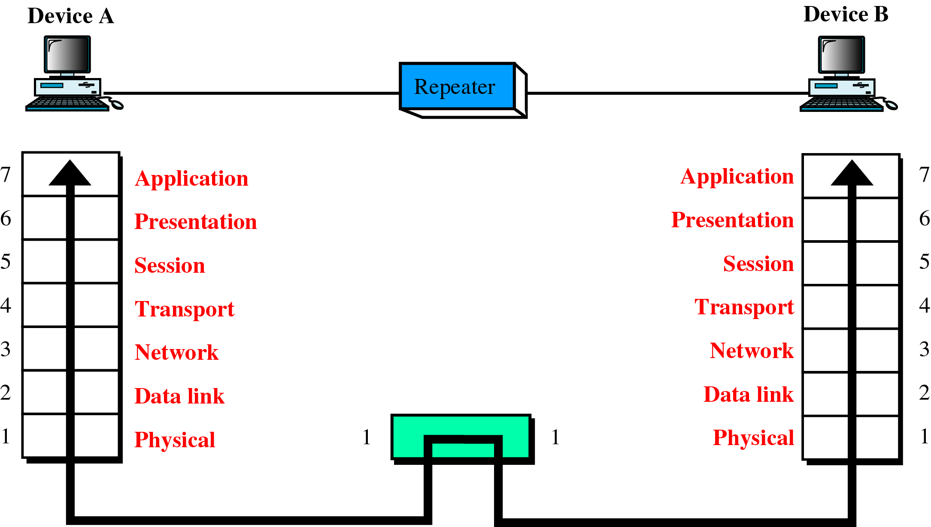
Hubs/Repeaters

Slide 5
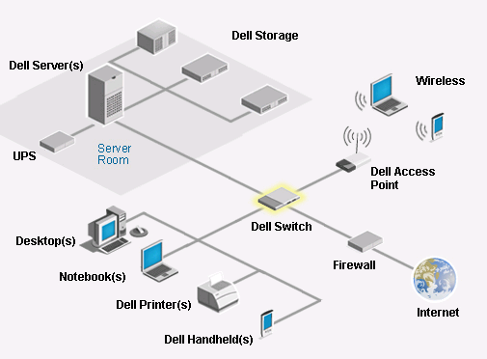
Switches
route data to the destination address only
(based on physical address)
isolate data flow based on connection
typically operate at layer 2

Slide 6
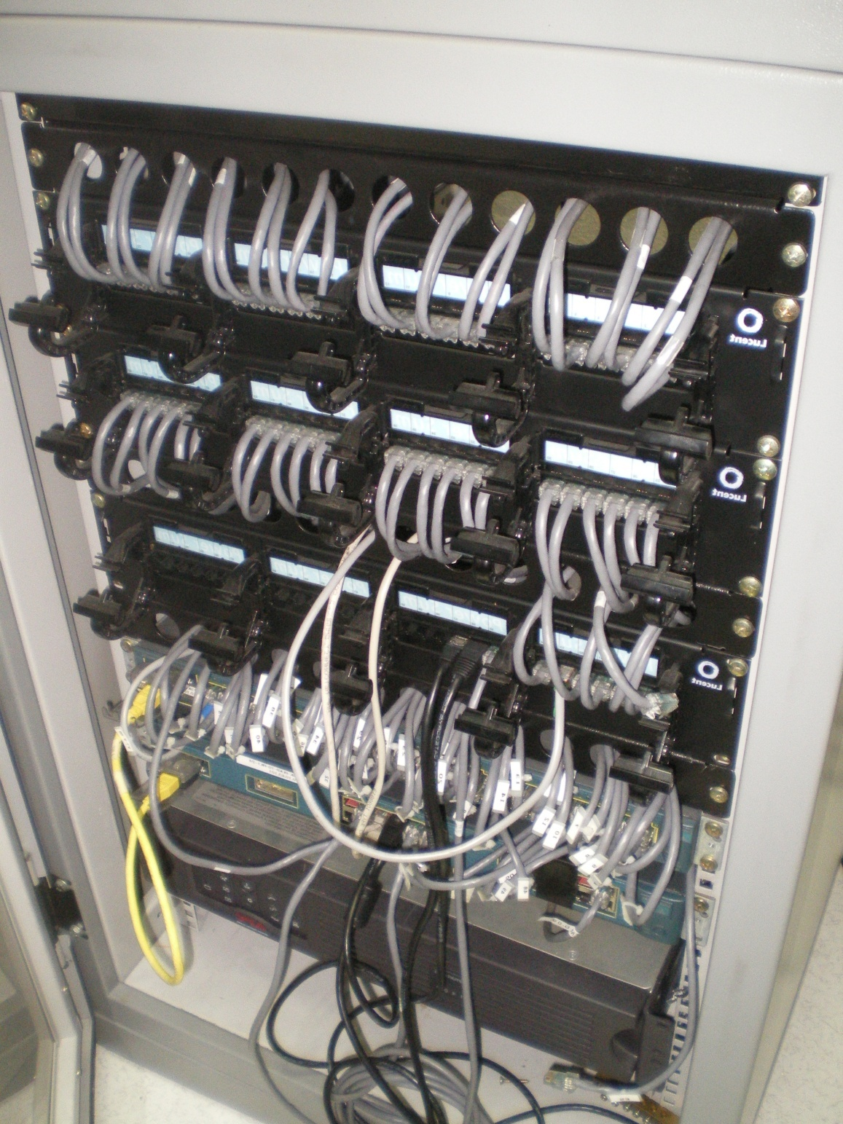
Switches
Access Switch
Seminar Room
( Block A :Aras 1)
Core Switches

Slide 7
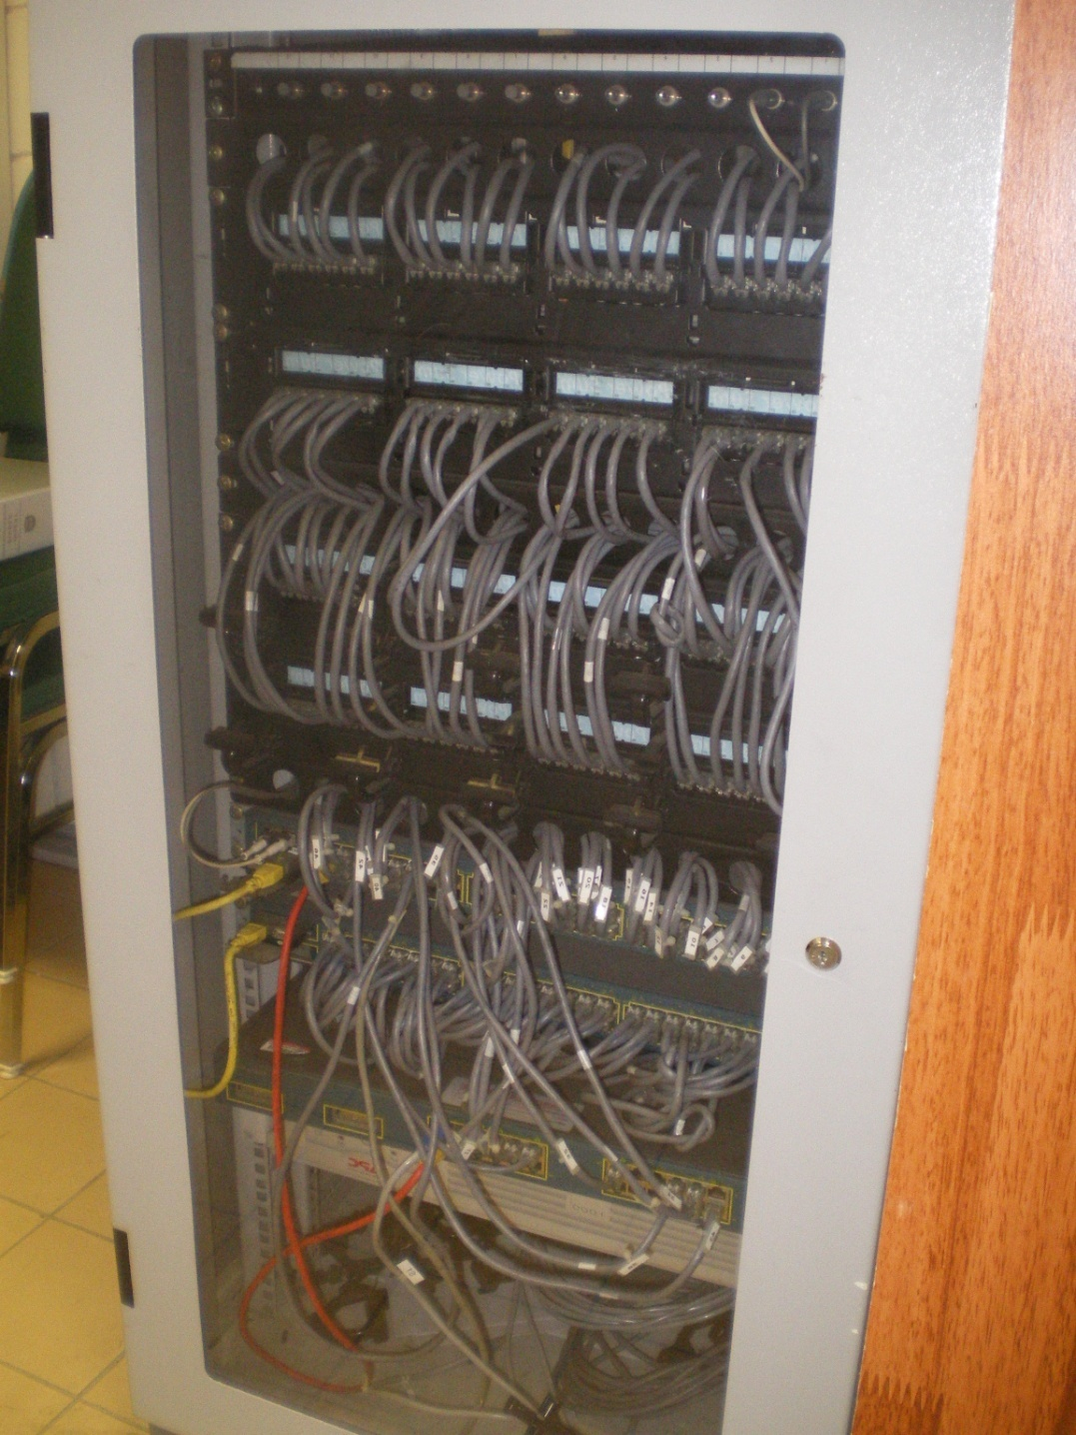
Switches
Access Switch
PDR Room
( Block A, Aras 3)
Core Switches

Slide 8
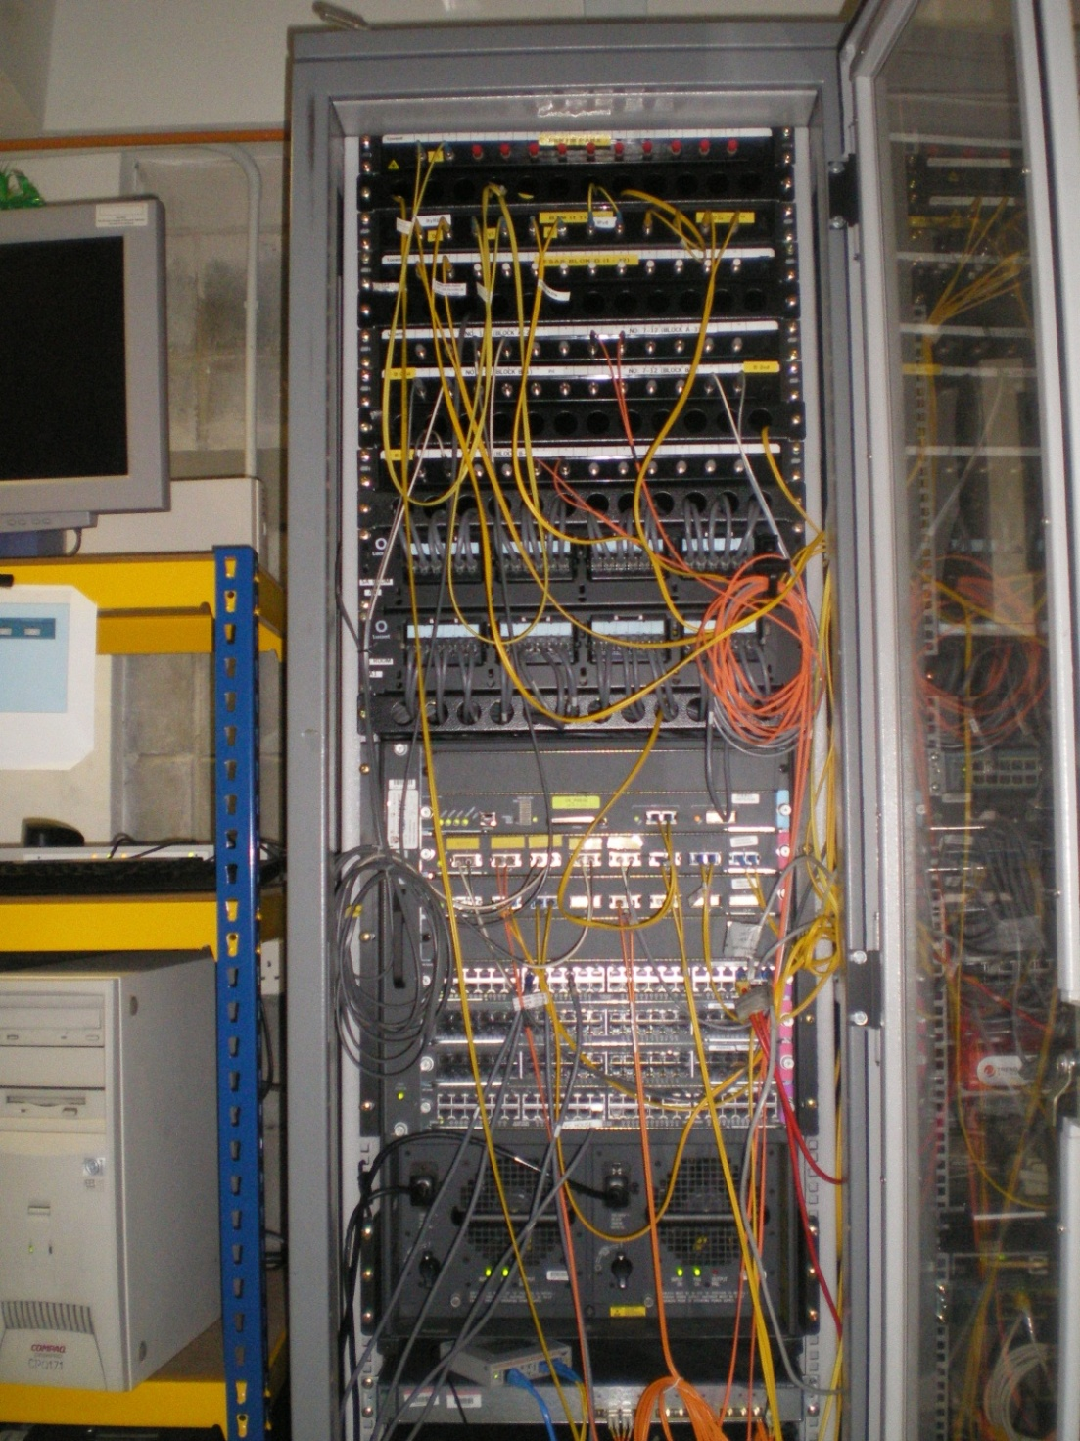
Switches
Core Switches
Server Room
( Block A, Aras 1)

Slide 9
FSKTMNet
Started operation : Jun 2001
Number of nodes: 1284
Network Equipment:
  1 Core switch
  3 Distributed switch
  34 Access switch

Slide 10
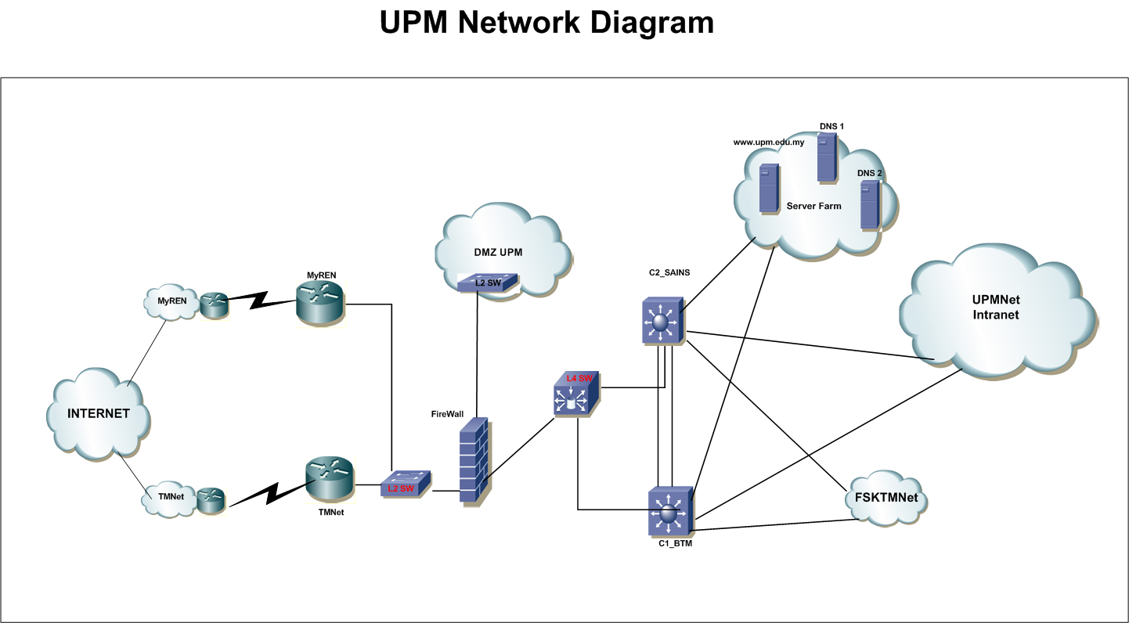
Routers
Routers

Slide 11
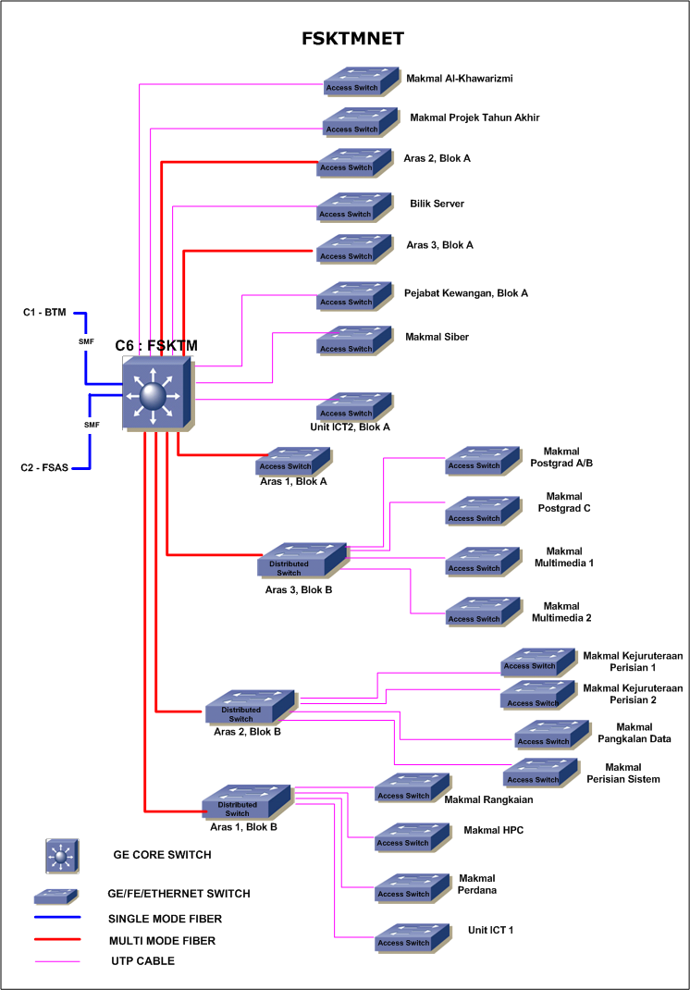

Slide 12
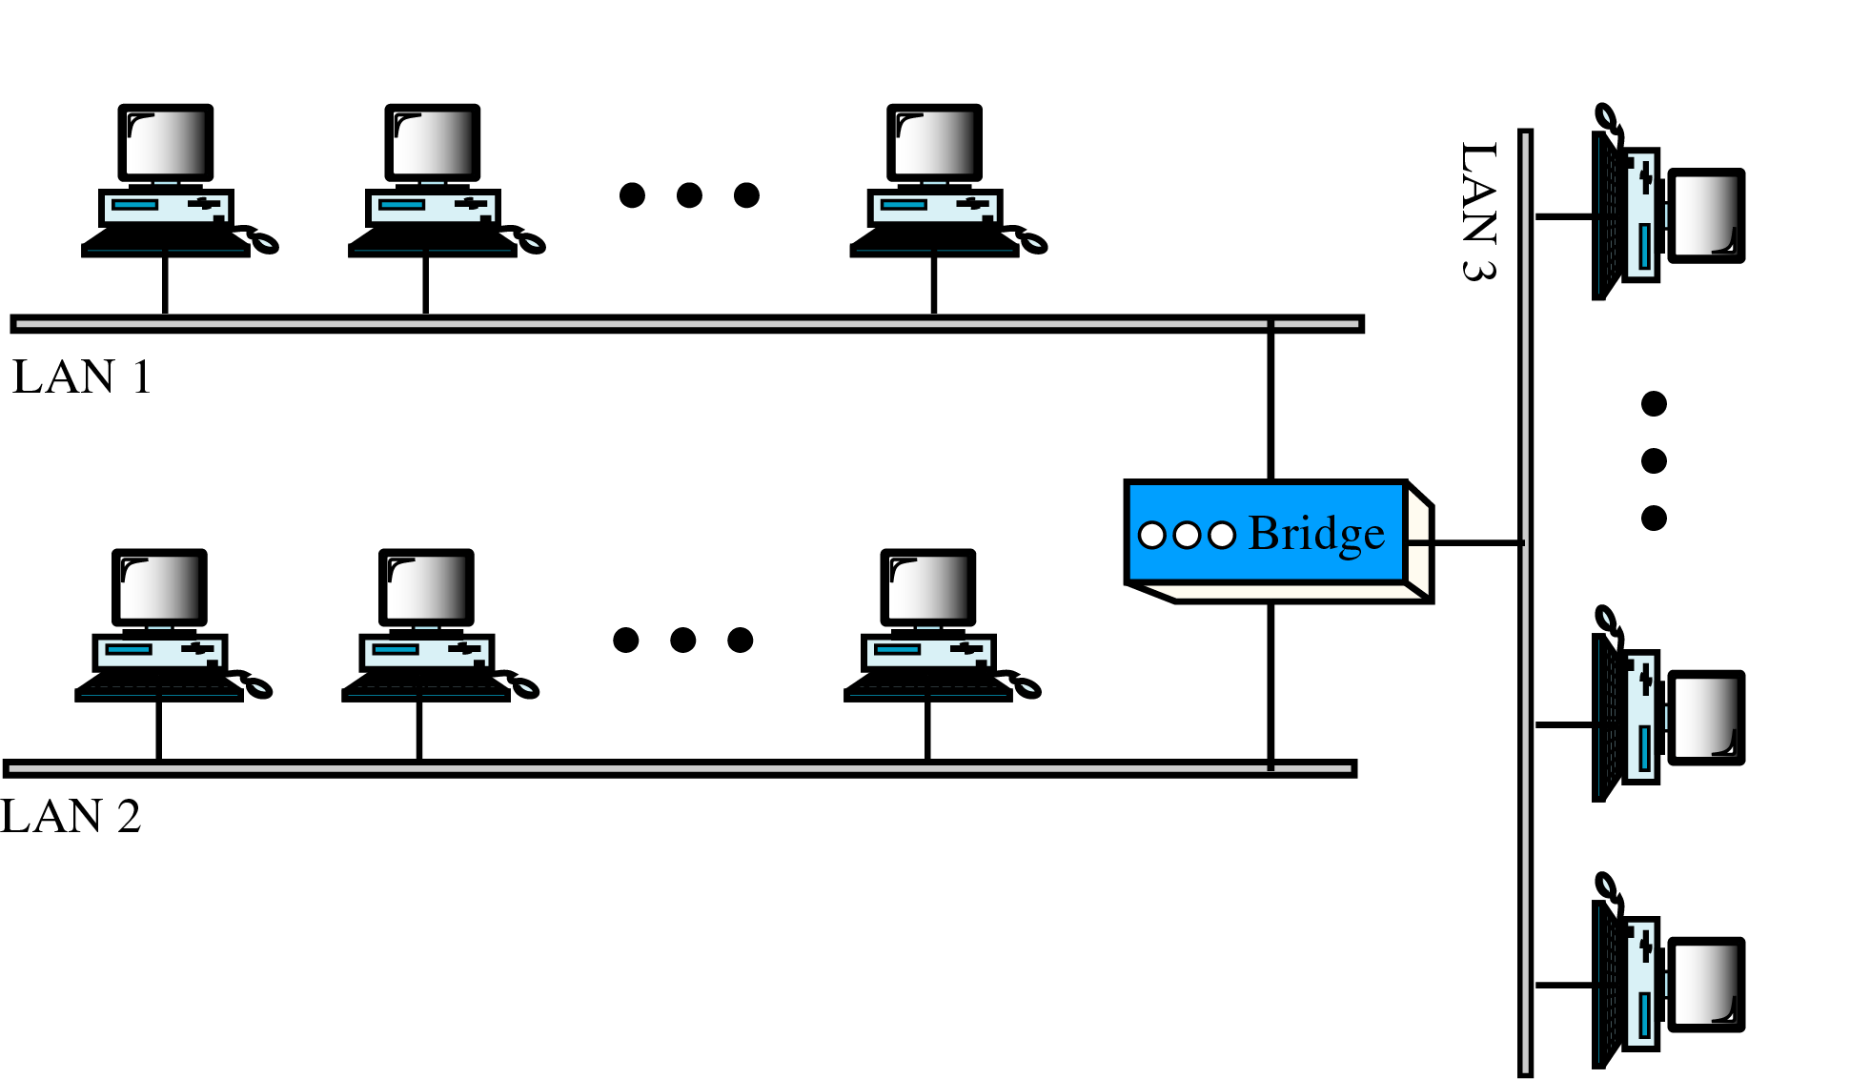
Bridges
work at Link Layer
used to connect 2 (LANs) or 2 segments of the same LAN
build up a table of which port a machine is connected to
filter data packets based on the MAC address

Slide 13
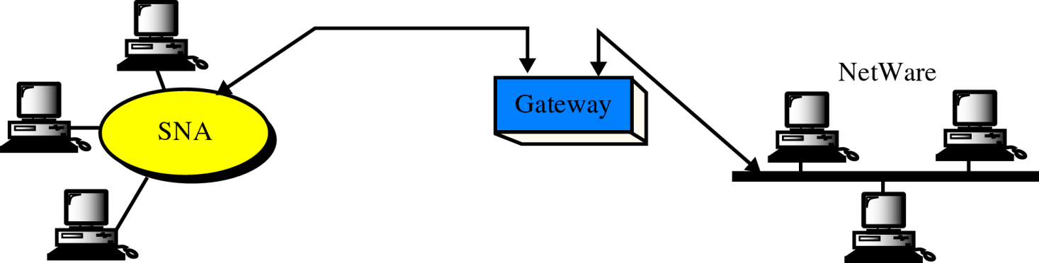
Gateways
also called protocol converters
can operate at any layer of the OSI Model
can be rate converters, fault isolators signal translators etc as to provide system interoperability
a gateway is an essential feature of most routers, although other devices can function as a gateway
an entry point and an exit point in a network

Slide 14
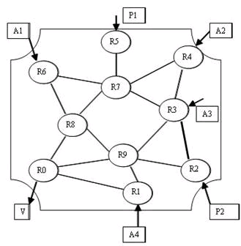
Routers
forward data depending on the IP address
work in networks using similar protocols
use routing algorithms to get the best path
operate in the 1, 2 and 3 layers

Slide 15
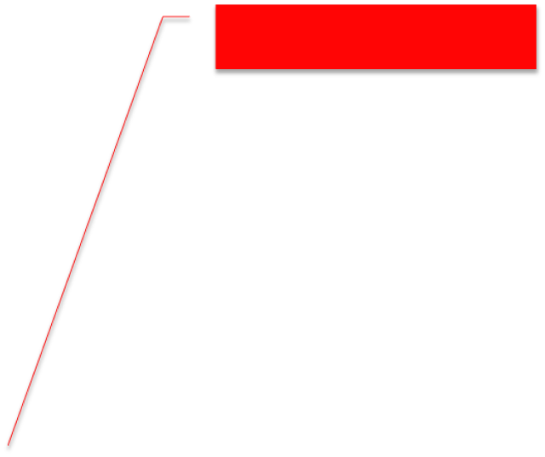
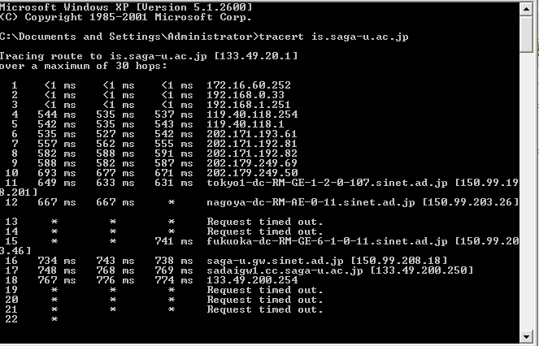
tracert is.saga-u.ac.jp
Routers

Slide 16
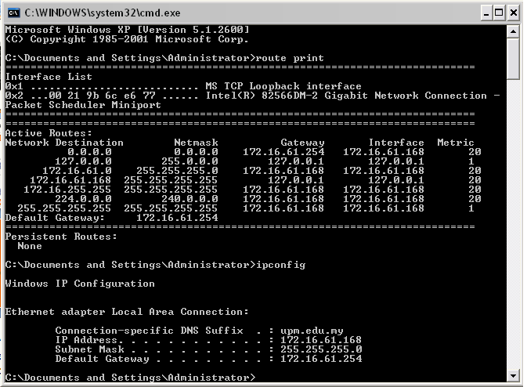
route print

Slide 17
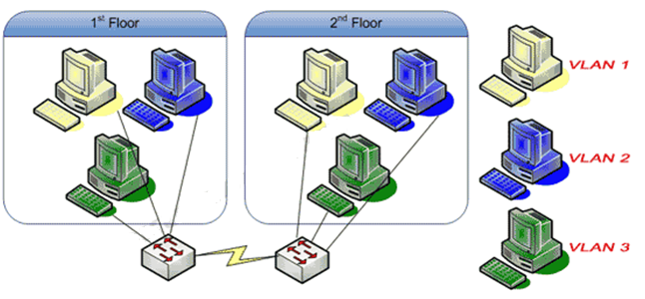
VLAN…
A VLAN (virtual local area network) is a collection of nodes that are grouped together in a single broadcast domain that is based on something other than physical location.
In simpler term, VLAN is a logical groups of devices that are defined by a software configuration, usually in switches.

Slide 18
Why VLAN?
Security - Separating systems that have sensitive data from the rest of the network decreases the chances that people will gain access to information they are not authorized to see.
Departments/Specific job types - Companies may want VLANs set up for departments that are heavy network users (such as multimedia or engineering), or a VLAN across departments that is dedicated to specific types of employees (such as managers or sales people).
Performance/Bandwidth - Careful monitoring of network use allows the network administrator to create VLANs that reduce the number of router hops and increase the apparent bandwidth for network users.
Broadcasts/Traffic flow - Since a principle element of a VLAN is the fact that it does not pass broadcast traffic to nodes that are not part of the VLAN, it automatically reduces broadcasts.

Slide 19
Types of VLAN
[1] Port–Based VLAN
Also known as Static VLAN
Specified by switch port. Each physical switch port is configured with an access list specifying membership in a set of VLANs.
Example:
  A 12 port fast Ethernet switch is split for the creation of 2 VLANs.
  The first 6 ports are associated with VLAN1 and the last 6 ports are associated with VLAN2.
  If a machine is moved from port 3 to port 11, it will effectively change VLANs.

Slide 20
Types of VLAN
[2] MAC-Based VLAN
Also known as Dynamic VLAN
Specified by MAC address. A switch is configured with an access list mapping individual MAC addresses to VLAN membership.
Example:
  A sys admin will enter MAC addresses for all machines connecting to the switch.
  These addresses will be stored in a memory chip inside the switch that forms a database of local MAC addresses.
  Each MAC address can then be associated with a certain VLAN.
  If a machine is moved, it will retain the original VLAN membership regardless of it's port number.

Slide 21
Types of VLAN
[3] Protocol–Based VLAN
A switch is configured with a list of mapping layer 3 protocol types to VLAN membership - thereby filtering IP traffic from nearby end-stations using a particular protocol such as IPX.
[4] ATM VLAN
using LAN Emulation (LANE) protocol to map Ethernet packets into ATM cells and deliver them to their destination by converting an Ethernet MAC address into an ATM address.

Slide 22
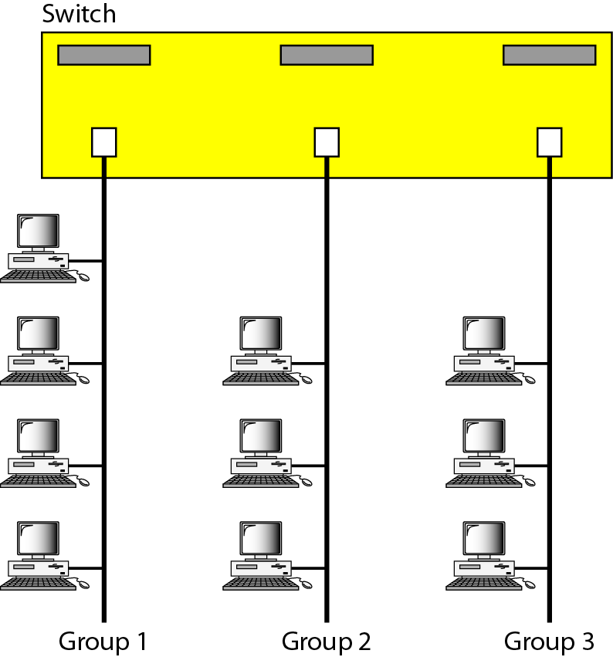
Sample VLAN Configuration:
Splitting VLAN per switch port
Figure 15.15 A switch connecting three LANs

Slide 23

Sample VLAN Configuration:
Specified VLAN per switch port

Slide 24

Figure 15.17 Two switches in a backbone using VLAN software

Slide 25
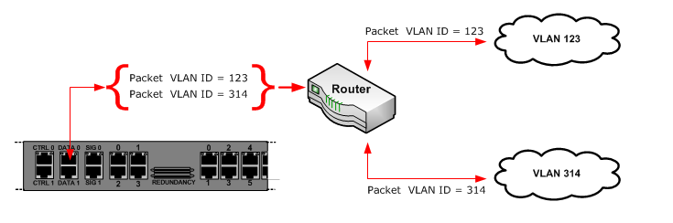
VLAN Tagging
When VLANs span multiple switches, VLAN Tagging is required. VLAN Tagging is the practice of inserting a VLAN ID into a packet header in order to identify which VLAN the packet belongs to. More specifically, switches use the VLAN ID to determine which port(s), or interface(s), to send a broadcast packet to.

Slide 26
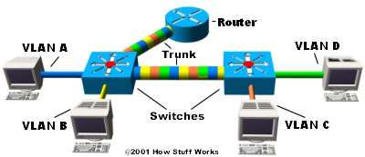
VLAN Trunking
When VLANs span multiple switches, a trunk data link is required between the switches. This is called VLAN Trunking and VLAN trunking protocol (VTP) is the protocol that switches use to communicate among themselves about VLAN configuration that are which port(s), or interface(s), to send a broadcast packet

Slide 27
VLAN Trunking: Example Scenario
Each switch has two VLANs.
On the 1st switch, VLAN A and VLAN B are sent through a single port (trunked) to the router and through another port to the second switch.
VLAN C and VLAN D are trunked from the second switch to the first switch, and through the first switch to the router. This trunk can carry traffic from all four VLANs.
The trunk link from the first switch to the router can also carry all four VLANs.

Slide 28
VLAN Trunking: Example Scenario
Using the router, the VLANs can communicate with each other via the trunking connection between the two switches
Data from a computer on VLAN A that needs to get to a computer on VLAN B (or VLAN C or VLAN D) must travel from the switch to the router and back again to the switch.
Because of the transparent bridging algorithm and trunking, both PCs and the router think that they are on the same physical segment!

